Slide 1
ABFSE Town Hall
May 27, 2021

Slide 2
Topics
Who is/is not back on campus for fall classes?
Release time survey
ABFSE Directory – present NBE results
ICFSEB letter – candidate eligibility
Candidacy language
Annual report follow-up

Slide 3
Who is back on campus?
Need to know in the office in order to determine site visits

Slide 4
Release time survey summary
45 responses
Recognized by various names/titles
Reassigned time
Compensation time
Contact hours
Point system
Contracted formula
Negotiated
Doesn’t matter b/c must work OT in order to cover all classes

Slide 5
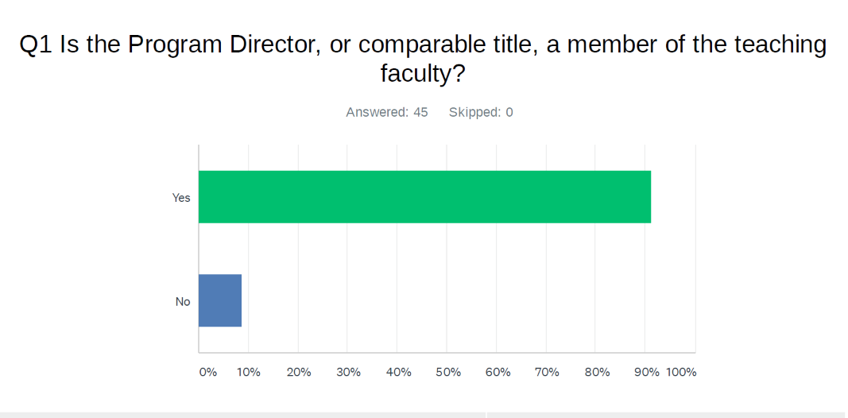
91% - Yes

Slide 6
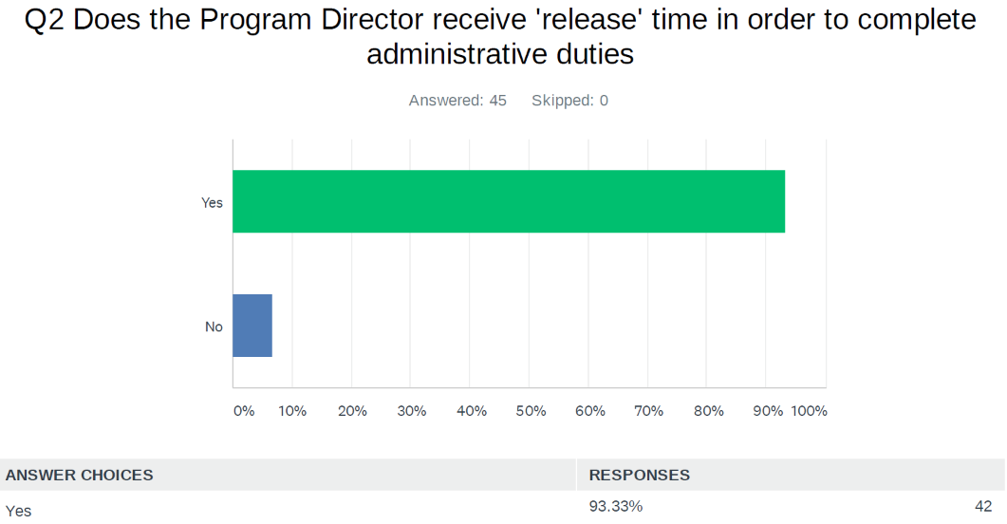

Slide 7
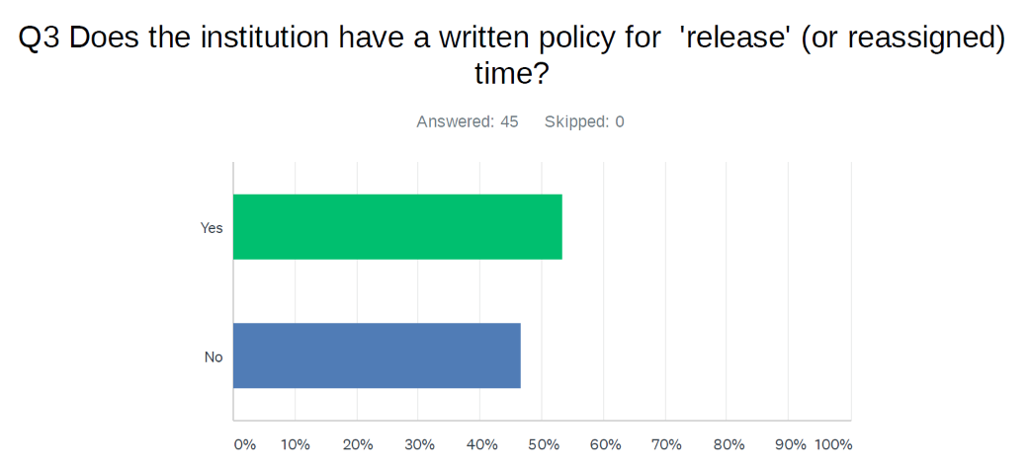
Yes - 53% No – 47%

Slide 8
How is release time determined?
Percent (or portion) of faculty load
Contact hours
Point system
Contracted formula
Negotiated
Doesn’t matter b/c must work OT in order to cover all classes

Slide 9
Results
Percent of load as release time (range)
28 responses of 45
7% - 66.6%
2 – Don’t know
6 – n/a
Mode is 20%

Slide 10
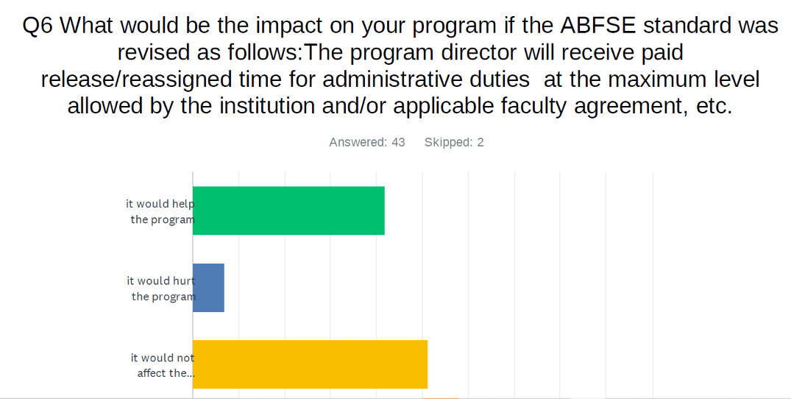
Help – 42% Hurt – 7% No impact – 51%

Slide 11
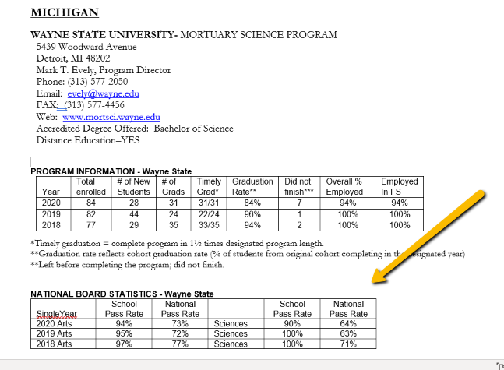
Directory – presentation of NBE results (new for 2021 – see arrow)

Slide 12
Directory – presentation of NBE results
See the American River College example. At the webpage, click on Explore Funeral Service Education.
https://www.arc.losrios.edu/academics/programs-and-majors/funeral-service-education
Programs may create a link to the ABFSE Directory as an option to present NBE and other student outcomes info. This will make ABFSE responsible to provide current, updated outcomes data.

Slide 13
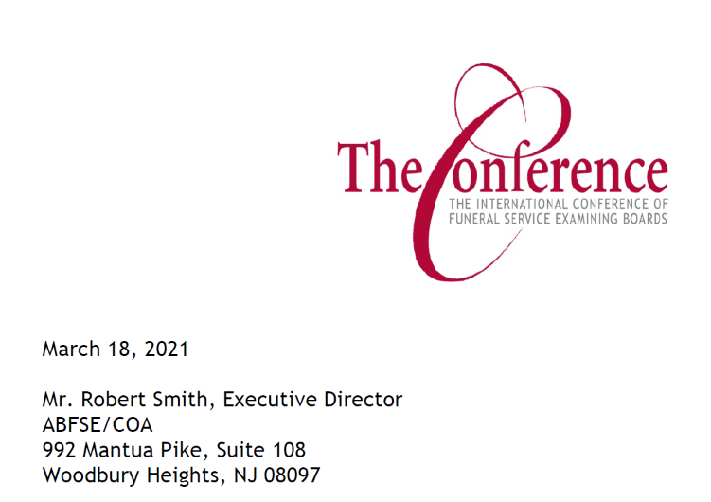
The Conference expresses concern

Slide 14
The Conference expresses concern

Slide 15
Reminder
USDE expects accreditors to evaluate licensing exam performance as part of the accreditation function.

Slide 16
Excerpt from Manual – Candidacy Language

Slide 17
Candidacy language
Is the current Candidacy disclosure language in the ABFSE Manual clear to prospective students?
Are improvements necessary?
Can you offer any suggestions?

Slide 18
Annual Report follow-up
Accuracy is important. Summary info is publicly disclosed.
Fulfill obligations to USDE and CHEA accreditation
Annual Report info goes in ABFSE Directory (review Directory info before publication)

Slide 19
CHEA expects Accreditors to:
Publish accreditation status
Make program webpage info available
Student outcomes via program webpage maximum 3 clicks w/clear pathway can be direct link to Directory (eliminates need for updates)
Reminder: USDE requires publication of department hierarchy (reason for question on Annual Report)

Slide 20
Announcements
Review corporate structure
Future annual conference format
Continued use of virtual meetings in some manner?
Formalize vote procedure for future virtual meetings
Scholarship eligibility language update. See website. https://www.abfse.org/html/scholarships.html
Where applicable, programs should review/evaluate student outcomes for traditional v. distance
Part-time program ? Do you offer this option?

Slide 21
Other????
ABFSE Committee vacancies to be filled:
Curriculum, Scholarship, Program, NBE Liaison,
Constitution and By-Laws
2021 Summer Curriculum Review – July 29-30

Slide 22
Inquiries
Prospective students ask, is the ABC program recognized in my state?
Federal requirement to disclose took effect July 1, 2020
https://www.abfse.org/docs/ProfLicensure.pdf

