Slide 1
Annual Report
AND Student Tracker
2024

Slide 2


Slide 3
STUDENT Tracker 2024 DATA
Info collected in Student Tracker is used to complete the Annual Report for 2022 and beyond
Access Annual Report via For Educators page of ABFSE website
http://www.abfse.org/html/educators.html
Access Student Tracker via Star.abfse.org
(access to Annual Report also)
STAR acronym = Student Tracker Annual Report

Slide 4
2024 Annual Report
Student Tracker replaced Cohort Tracking
Log-in for Annual Report
Print Instructions first (at least read them)
Preview and/or print the sample forms

Slide 5
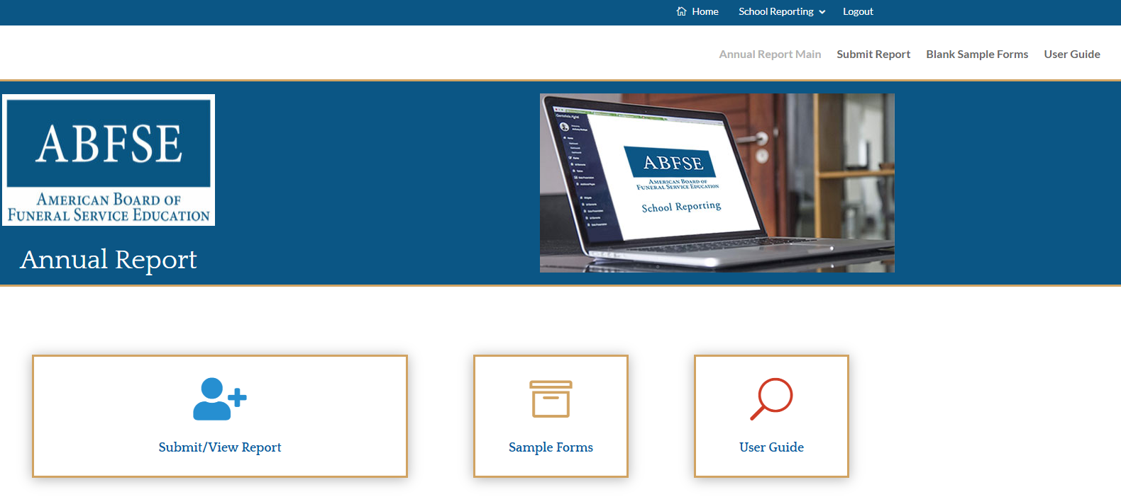


Slide 6
student Tracker. update these entries before you start the Annual Report
Will summarize data needed to complete demographics section of Annual Report.
Be sure Student Tracker entries are correct before you start the Annual Report.
From Student Tracker you can create:
Lists of Graduates, New Enrollees, DE Grads
Submit Annual Report electronically by February 15, 2025

Slide 7
Instructions (aka User Guide)
Verify numbers in Student Tracker before starting the Annual Report
Note: transfer will be automatic.
Changes made to Student Tracker data after the start the Annual Report will NOT update.
Must be done manually.

Slide 8
Annual Report
Due February 15 ,2025
Submit electronically
Digital signature is included

Slide 9
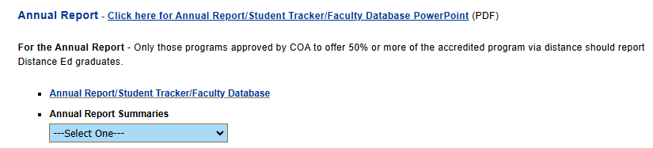
Find Annual RePort
Go to For Educators page https://abfse.org/html/educators.html
  Scroll down to
  Or use drop down menu for Annual Report
cclick here

Slide 10
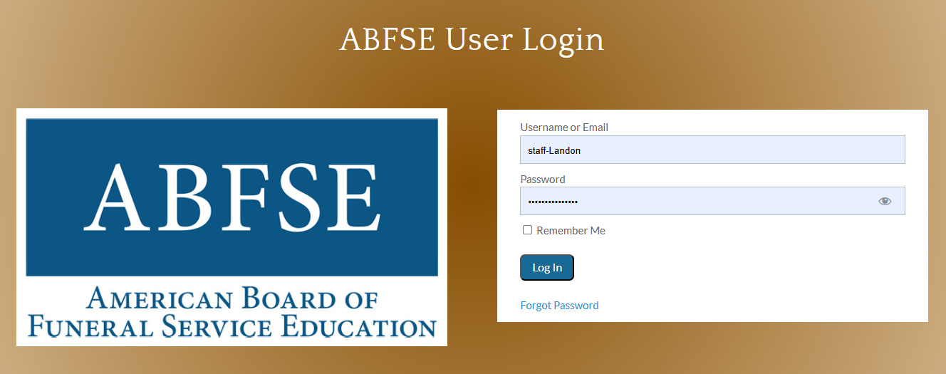

Getting started

Slide 11
Log in
Username is your email address (unless you changed it at initial setup)
Password – you created. ABFSE has no record of it.
    can change old password
    Use Forgot Password option

Slide 12
Getting Started
Update Student tracker 1st
Update Faculty database
Info from both autofills to Annual Report
Look at Sample Forms
(Can put info in Sample Forms, but it will not save)

Slide 13
Annual report
See sample forms on website
Print a blank copy after sign-in, if you prefer.
A good way to review the Annual Report questions before you get started.
Fyi: when you submit, you are reminded to keep a copy.
Copy is a summary of your responses.
Not the same forms you originally completed.

Slide 14
Annual report includes
10 sections
+ Final Preview
+ Certification page (requires signatures)

Slide 15
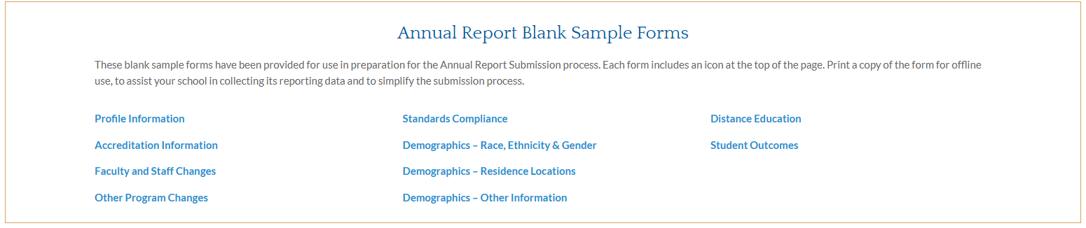
Sections of Annual Report

Slide 16
General
Review pre-filled info and make any necessary changes
Must click continue to advance to next page
(click continue automatically saves)
You can stop/start as many times as you like, BUT when you re-start you will go automatically to the last entry.
From Final Preview page you can return to any point to make corrections.
You cannot submit an incomplete report.

Slide 17
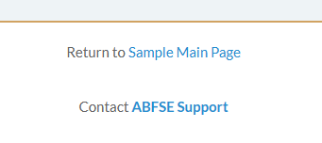
Reminders
Bottom of every page
Goes to generic email
Can also contact M. Landon directly

Slide 18
Annual report
Access via For Educator page to start; includes instructions
http://www.abfse.org/html/educators.html
Print instructions first (or at least read them!)

Slide 19
Profile information
Accreditation Information
Pre-fills with last year’s info. Be sure to make any necessary amendments.
Notes: Program webpage
College website
US Department of Ed wants info about Department,
i.e. who do you answer to?
Some programs have department status within the institution, but still answer to a Dean or V-P of some area.

Slide 20
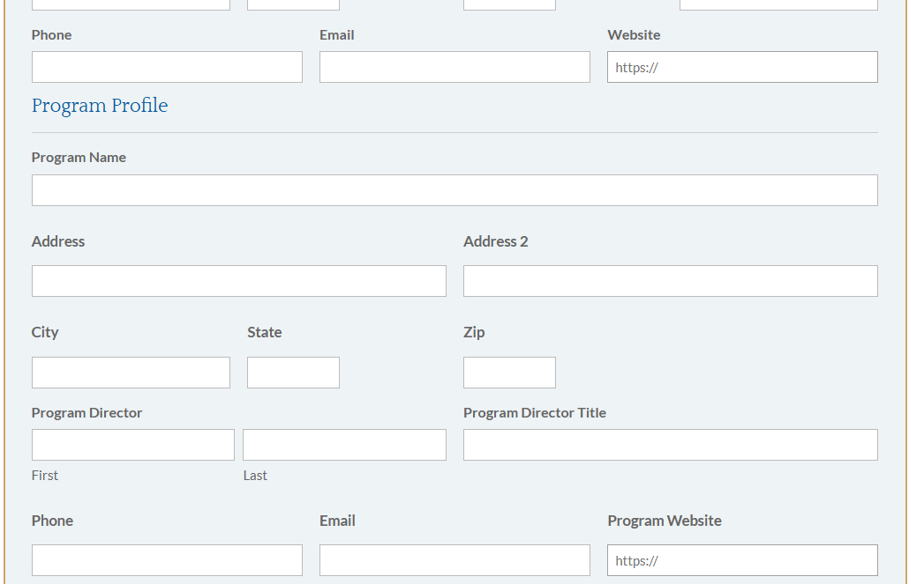


Program v. Institutional website

Slide 21
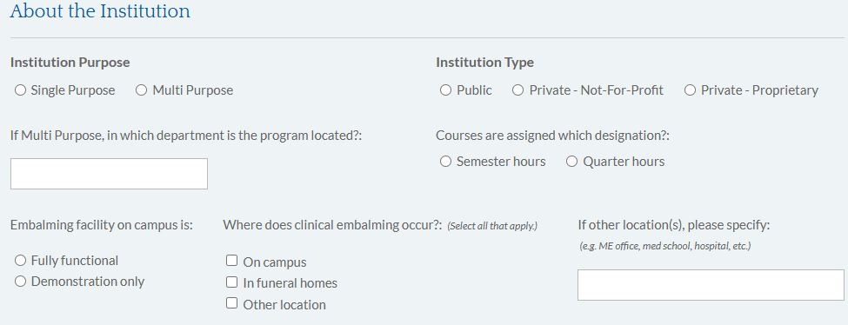
Profile information

Slide 22
Embalming facility
If embalming occurs at a trade service, designate as ‘in funeral home’ (most are licensed like funeral homes)
Use ‘Other’ for facilities that are not used primarily for embalming. See examples on form.

Slide 23
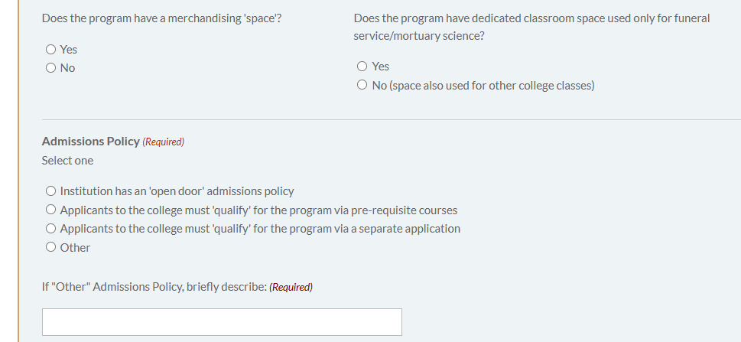
New questions

Slide 24
Dedicated classroom
Single purpose schools should answer ‘yes’ even if Gen Ed classes are taught in the same room.

Slide 25
Admissions
When new applicants can enter directly into funeral courses this is ‘open door’.
If applicants can enter the institution but have another layer of requirements before entering funeral courses, select the response that best applies.

Slide 26
Profile information
Accreditation Information
Annual Report collects detailed info regarding accredited programs.
Non-accredited programs are offered by at least 16 institutions and 6-7 offer bachelor degree completion programs.
Annual Report focuses on the accredited programs leading to initial (complete) licensure in the profession.
Limited info on the Bachelor degree completion and non-accredited programs is collected.

Slide 27
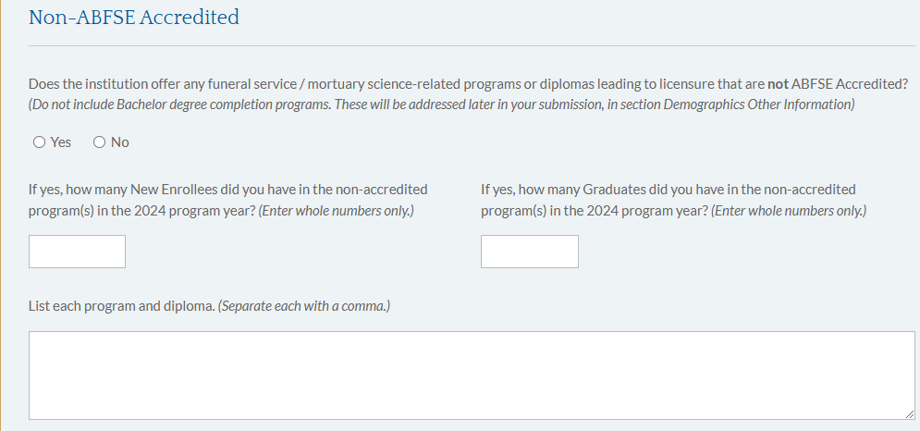
Non-accredited programs

Slide 28
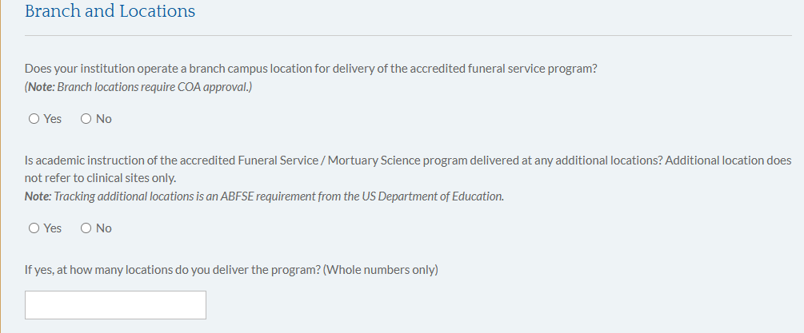
Branch &/or additional locations

Slide 29
Branch &/or additional locations
These are federally mandated questions.
None of the current ABFSE programs in 2023 operated a branch campus. This requires special approval.
Additional locations – only 1 ABFSE program operated an additional location in 2023.
If unsure, contact the ABFSE office before you submit.

Slide 30
Other Program changes
When a ‘yes’ response is provided, be sure to describe.
Indicate + and – for enrollment changes
Reminder: % sign is unnecessary.
Prior enrollment pre-fills.
Notify the ABFSE office if an error exists.
Some changes require Substantive Change form – See Manual, Appendix K

Slide 31
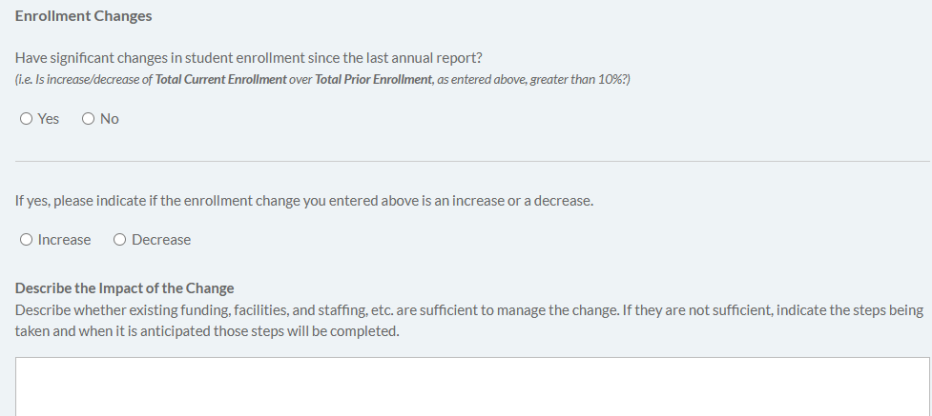
Yes ? Must describe

Slide 32
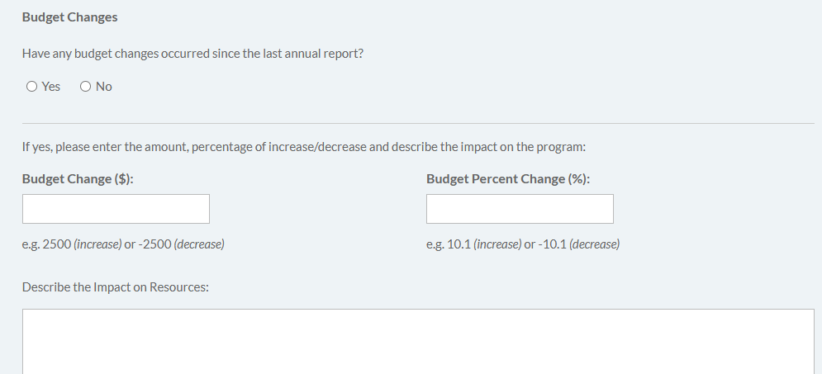

Other Program Changes - Budget

Slide 33
Standards compliance
Annual Report responses in Section 3 should correspond to info provided in the Self study (e.g. frequency of surveys, etc.)
Student complaints are to be reported via Annual Report (Standard 3.4)
Student complaints do require follow-up action
(expect review of complaints during site visit)

Slide 34
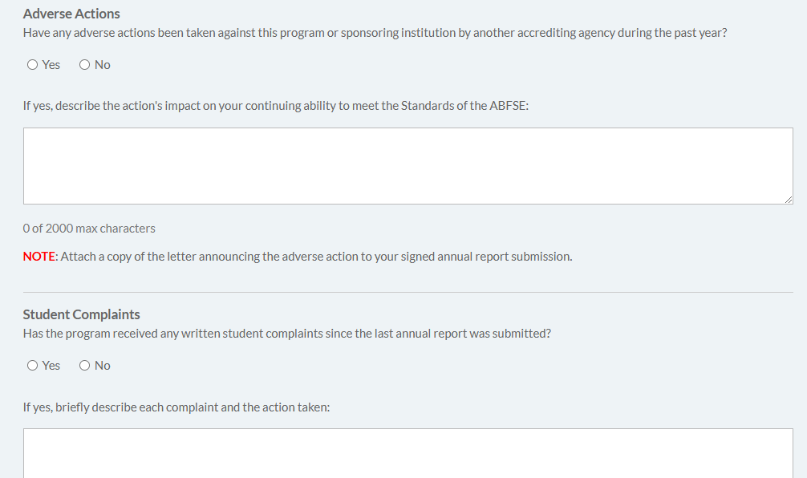
Accurate reporting is essential

Slide 35
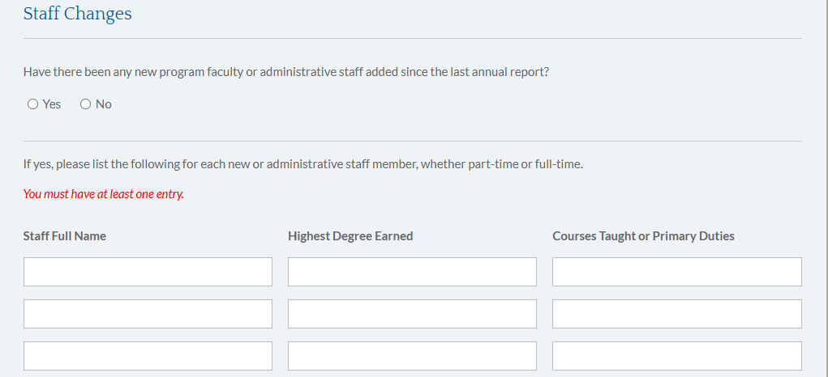
Staff changes – focus on faculty

Slide 36
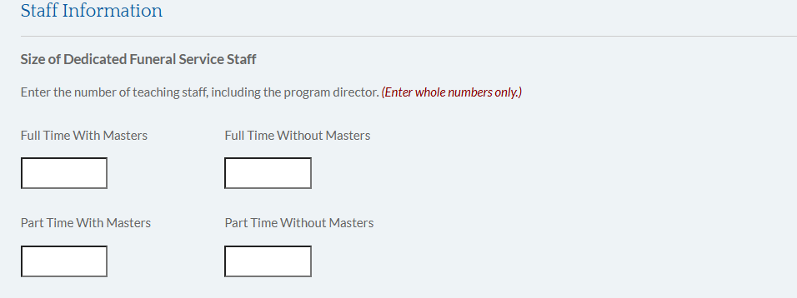
Staff size (include PD, unless ???)

Slide 37
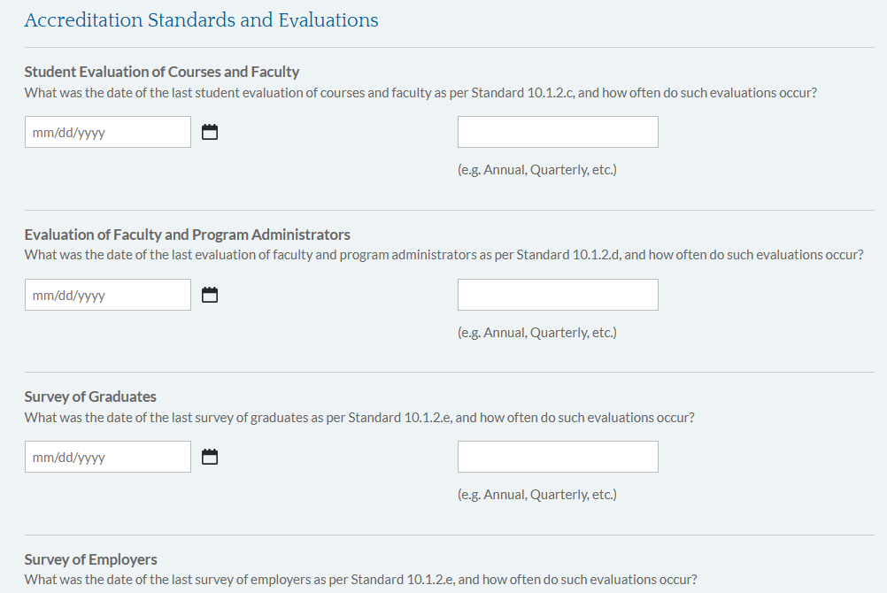
Survey info must be consistent with self study documentation

Slide 38
Demographics
(collected via student tracker.)
Demographic info is reported in the aggregate.
Number of New Enrollees and Graduates should match the number of names on the attached lists.
Counts must be consistent and you will not be able to submit an Annual Report with errors. (counts that do not match is an error!)

Slide 39
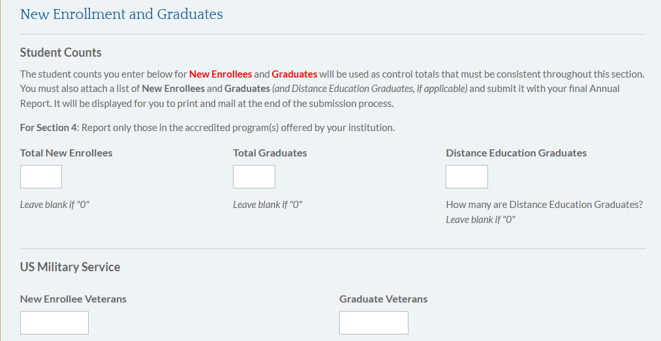
Demographics
Note use of ‘0’

Slide 40
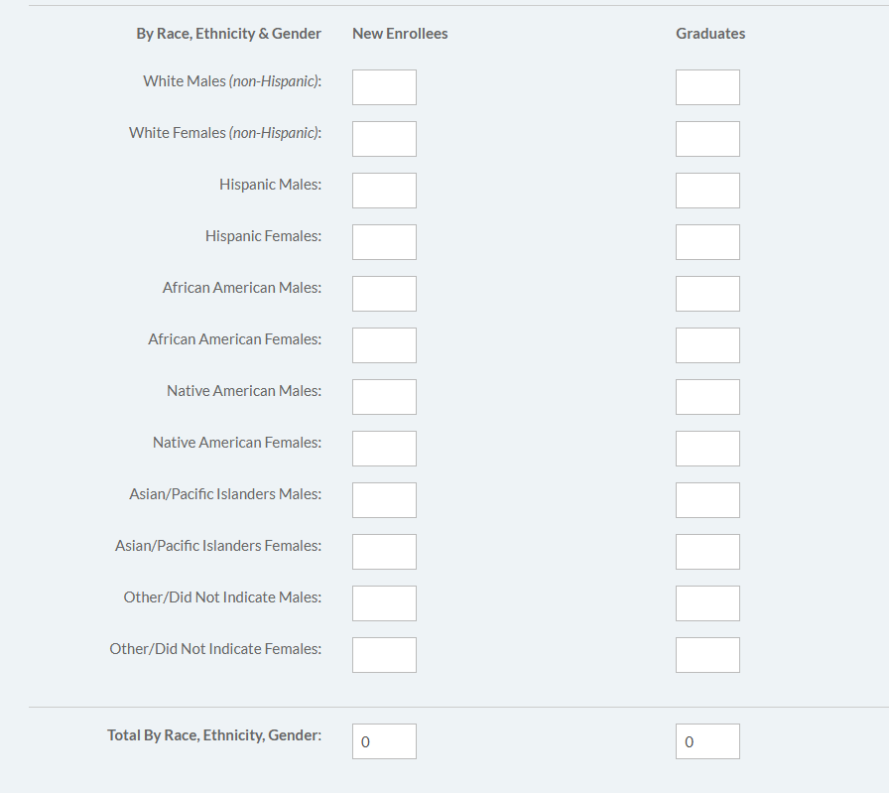
Autofills from Student Tracker.
Blanks are acceptable here.
Control number

Slide 41
Demographics
(info is collected via student tracker)
Individual student responses are not identified or tracked.
Program director (or assignee) typically completes the report.
Number of New Enrollees and Graduates must match the number of names reported.
Count must be consistent.

Slide 42
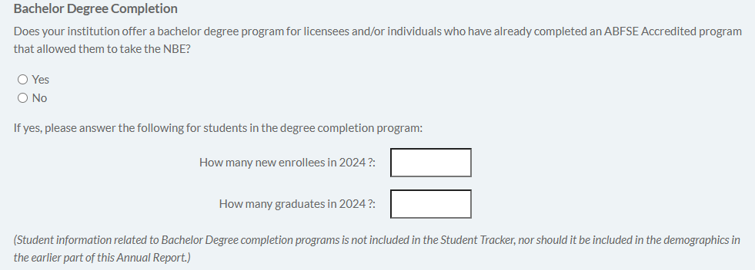
Bachelor Degree Completion
<10 appear to offer this option
Bachelor degree completion applies to students who previously completed an accredited program leading to licensure. Do not count a 2nd time.
Bachelor degree completion is NOT for programs offering a bachelor degree designed to accomplish initial licensure (i.e. Wayne State, SUNY-Canton, U CO, SIU, etc.)

Slide 43
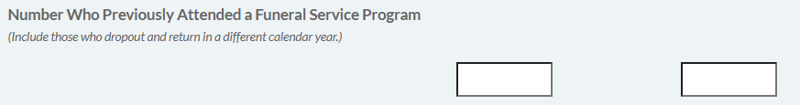
previously attended
Use for student who attended another program or left and returned to your program in a different reporting year (i.e. included in attrition report)

Slide 44
Distance education
Everyone answers at least 2 of the first 3 questions.
Continue if some level of DE is offered.
Tracking for Gen Ed only, <50% of program via DE, and 50% and +
Designate the number of DE grads who take the NBE.
These numbers will be tracked with the list of DE grads.
If the answer to USDE compliance is ‘no’, there is a PROBLEM!

Slide 45
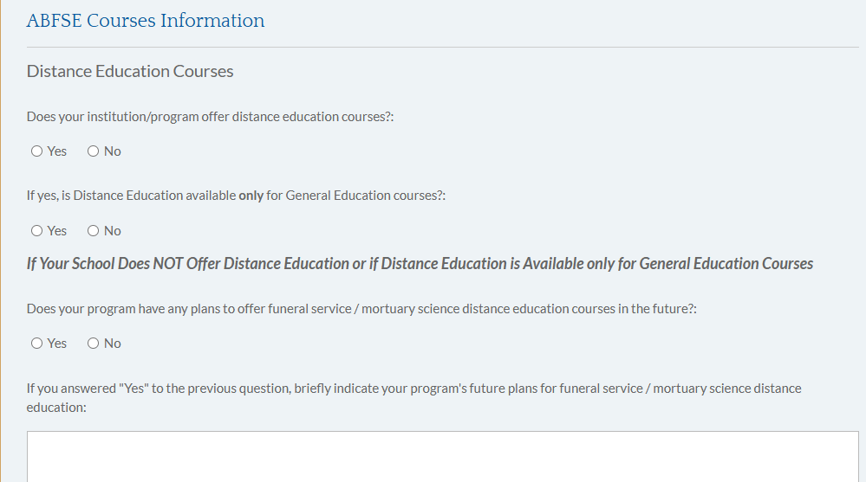
Distance Education
Everyone answers these questions

Slide 46
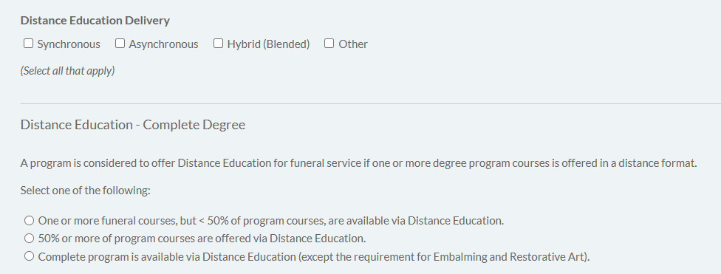
NEW approach to DE questions

Slide 47
Student outcomes
% boxes only require a number (no % sign).
Verify the number of NBE takers with your ICFSEB reports.
Reminder: for job placement – a survey at graduation is acceptable. It is not necessary to wait 6 months to track employment.
Improved job placement results after 6 months should be documented
report for site visit
ABFSE Directory is updated June and December

Slide 48
Reminders found throughout
You must click continue at the bottom of each page.
This also saves the work.
You can complete the Annual Report pages in any order.
You can stop/start at any time and go back to finish later.
Corrections/amendments made to autofill info on Annual Report do not flow back to Student Tracker or Faculty database. You must enter changes in the source program.

Slide 49
Final Preview
Correct errors/omissions in order to submit.
Print/save a copy for your records.
Certification page requires 2 signatures.
Electronic signature is now available.
Graduate and New Enrollee lists are available via Student Tracker.
Note: incomplete or late reports are subject to Administrative Probation and fine.

Slide 50
Final Preview
Errors and omissions appear in red.
Cannot submit the final report if there are blanks.
Zero ‘O’ is an acceptable response. Leaving a blank is not.
(exception is in Demographics)
When response calls for an answer in %, a whole number is expected (no % sign)

Slide 51
Submit Due Date: February 15, 2025
Late reports delay processing.
Fines are applicable.
Submit electronically via website by deadline.
Follow-up with copy that includes lists.
Overnight is not necessary as long as electronic copy is submitted on time.
Help is available: email or phone.

Slide 53
Student Tracker
(some additional reminders)

Slide 54
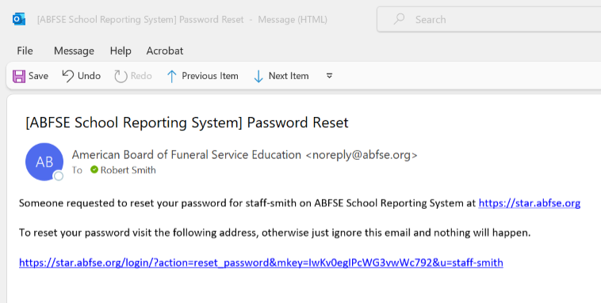
Change password in Student Tracker (LiNK VIA email)

Slide 55
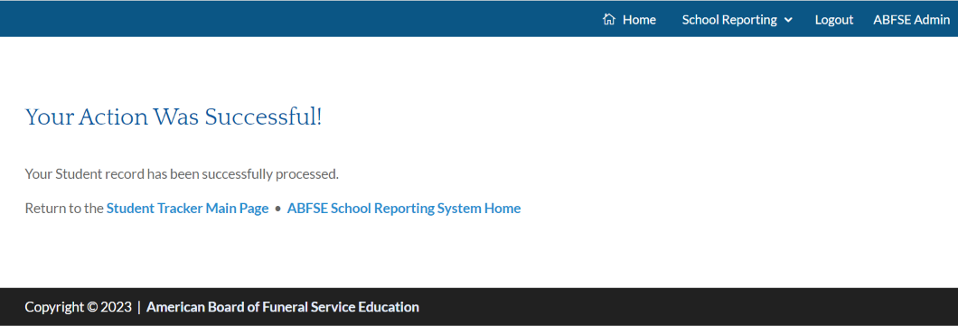
Message when student info is input

Slide 56
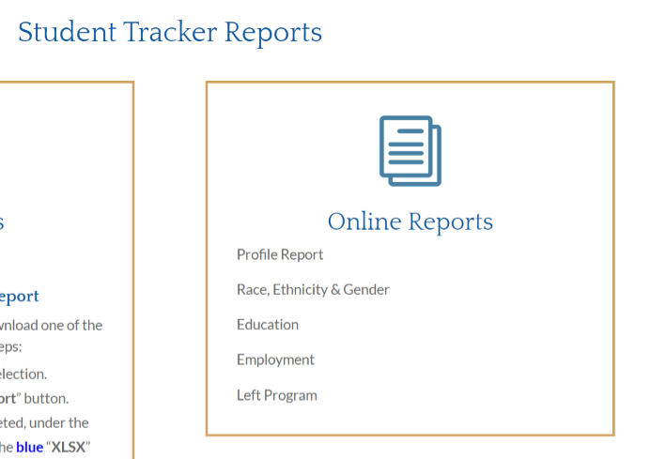
Report options from Student Tracker (verify input via the reports)

